Slide 1




DIGITAL LITERACY
SKILLS
ADVANCED USERS

Slide 2

Module 5
Safety and security

Slide 3

4
Unit 4: Protecting the environment

Slide 4
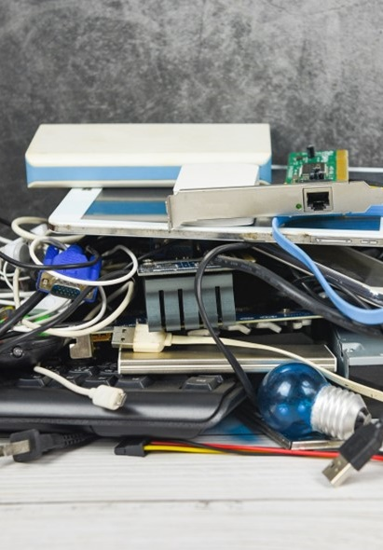
Proper disposal of electronic devices
Computers and other electronic devices contain different metals, plastics, raw materials and chemicals, and need to be disposed of correctly.
Types of electronic devices include:
computers, smartphones, and tablets
digital media
external hardware and peripheral devices
gaming consoles.

Slide 5
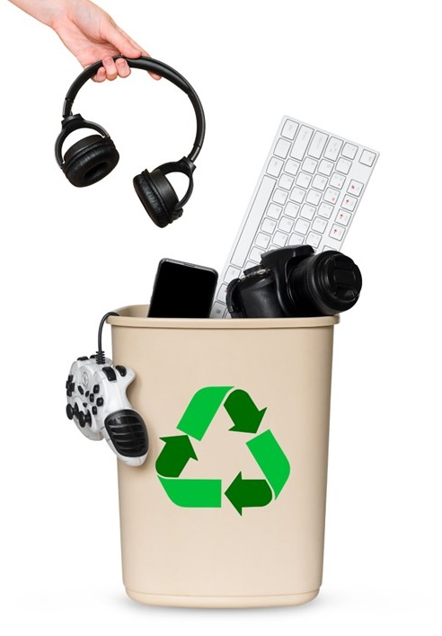
Safely disposing of out-of-date electronic devices
Electronic waste, or e-waste, is a term used to describe electronics that are nearing the end of their useful life and are donated or recycled.
Dispose of e-waste by contacting a business that specializes in e-waste disposal and requesting a designated e-waste drop off location.
Be aware that, although there are many options for disposal, it is your responsibility to ensure that the location chosen is reputable and certified.

Slide 6

Effective methods for removing data from devices
Remove all sensitive information before donating or discarding old devices.
You may accidentally disclose sensitive information, which could be exploited by cybercriminals.
There are a variety of methods for permanently erasing data from your devices (also called sanitizing).
Methods of sanitization vary according to device.
Before sanitizing a device, back up your data if you still want it.

Slide 7
Sanitizing electronic devices
Methods for sanitization include:
Deleting data | Use a disk cleaning software designed to permanently remove the data stored.
Secure erase | This is a set of commands it will erase the data by overwriting all areas of the hard drive.
Disk wiping | Erases sensitive information on hard drives and securely wipes flash drives and secure digital cards.
Smartphones and tablets | Erase data by performing a ‘hard reset’.
Digital cameras, media players, and gaming consoles | Perform a standard factory reset.
Office equipment | (e.g., copiers, printers, fax machines, multifunction devices): Remove any memory cards from the equipment.

Slide 8
Skills to practise
Learn about carbon footprints
Complete an internet search on the meaning of a ‘carbon footprint’, research how the use of electric digital technology adds to the carbon footprint.
Draw up a strategy on how to reduce a carbon footprint, while still using digital technology.

Slide 9
All back covers should include
contact information of the section
producing the work.
© United Nations Children’s Fund (UNICEF) [month and year of publication]

